Slide 1
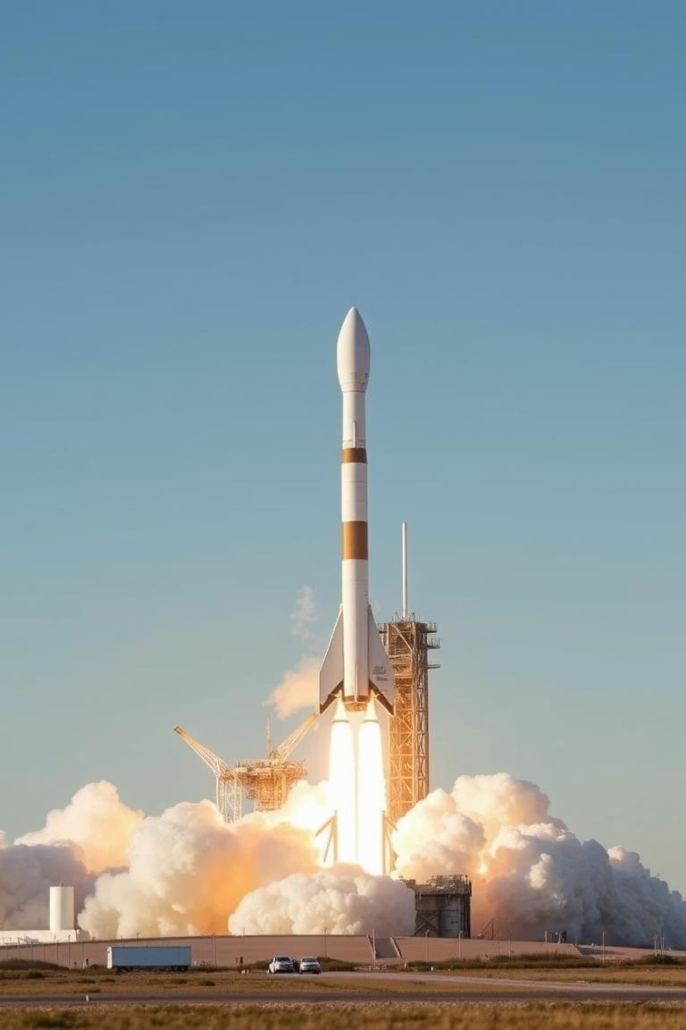
SpaceX Falcon 9 First Stage Landing Prediction
A Data Science Project by Timasha wanninayaka
Date: 2025 July 21

Slide 2




Executive Summary
This project aimed to predict the successful landing of SpaceX Falcon 9's first stage. Our analysis involved a multi-faceted approach, leading to significant insights.
Objective
Methodology
Key Findings
Predict Falcon 9 first stage landing success.
Data Collection, Wrangling, EDA, Predictive Modeling.
Success improves with reusability and specific launch sites.

Slide 3
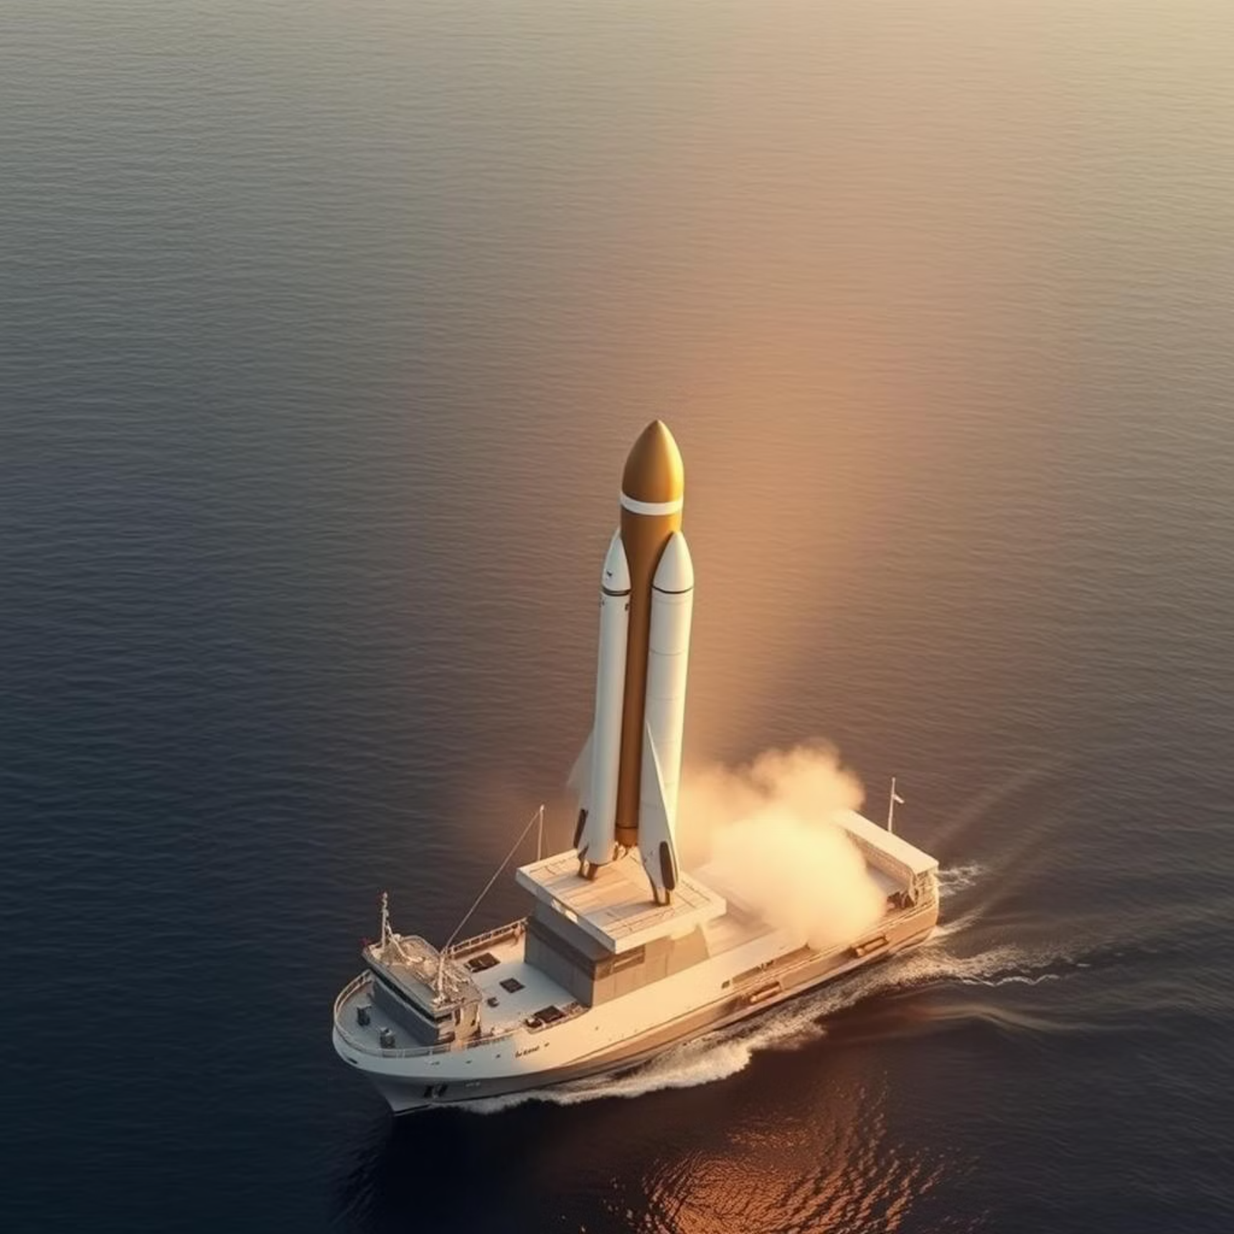
Introduction: The Quest for Reusability
SpaceX's innovation in reusable rockets is revolutionizing space travel by drastically reducing costs. Our project addresses a critical challenge: predicting the success of these complex landings to optimize future missions.
Why SpaceX? Reusable rockets dramatically cut launch costs, making space access more affordable and frequent.
Problem Statement: Accurate prediction of landing success is vital for mission planning and resource allocation.
Our Approach: We analyzed historical launch data from 2010 to 2023 to build a robust Machine Learning model capable of forecasting future landing outcomes.

Slide 4



Data Collection Methodology
Our project leveraged a combination of direct API access and web scraping to gather comprehensive data on SpaceX Falcon 9 launches.
SpaceX API
Web Scraping
Tools
Primary source for detailed launch data.
Wikipedia provided supplementary data for richer context.
Python with Requests and BeautifulSoup for efficient data extraction.
api.spacexdata.com/v4/launches
Data Wrangling Methodology
Transforming raw data into a clean, usable format was a crucial step. Our methodology focused on standardization and feature engineering for optimal model performance.
Standardize Payload Mass
Handle Missing Values
Converted various units to a consistent metric (e.g., kg) for comparability.
Implemented strategies like imputation or removal based on data characteristics.
Tools Utilized
One-Hot Encode Categorical Variables
Leveraged Pandas for data manipulation and NumPy for numerical operations.
Transformed qualitative features like 'launch site' into numerical format for modeling.

Slide 5
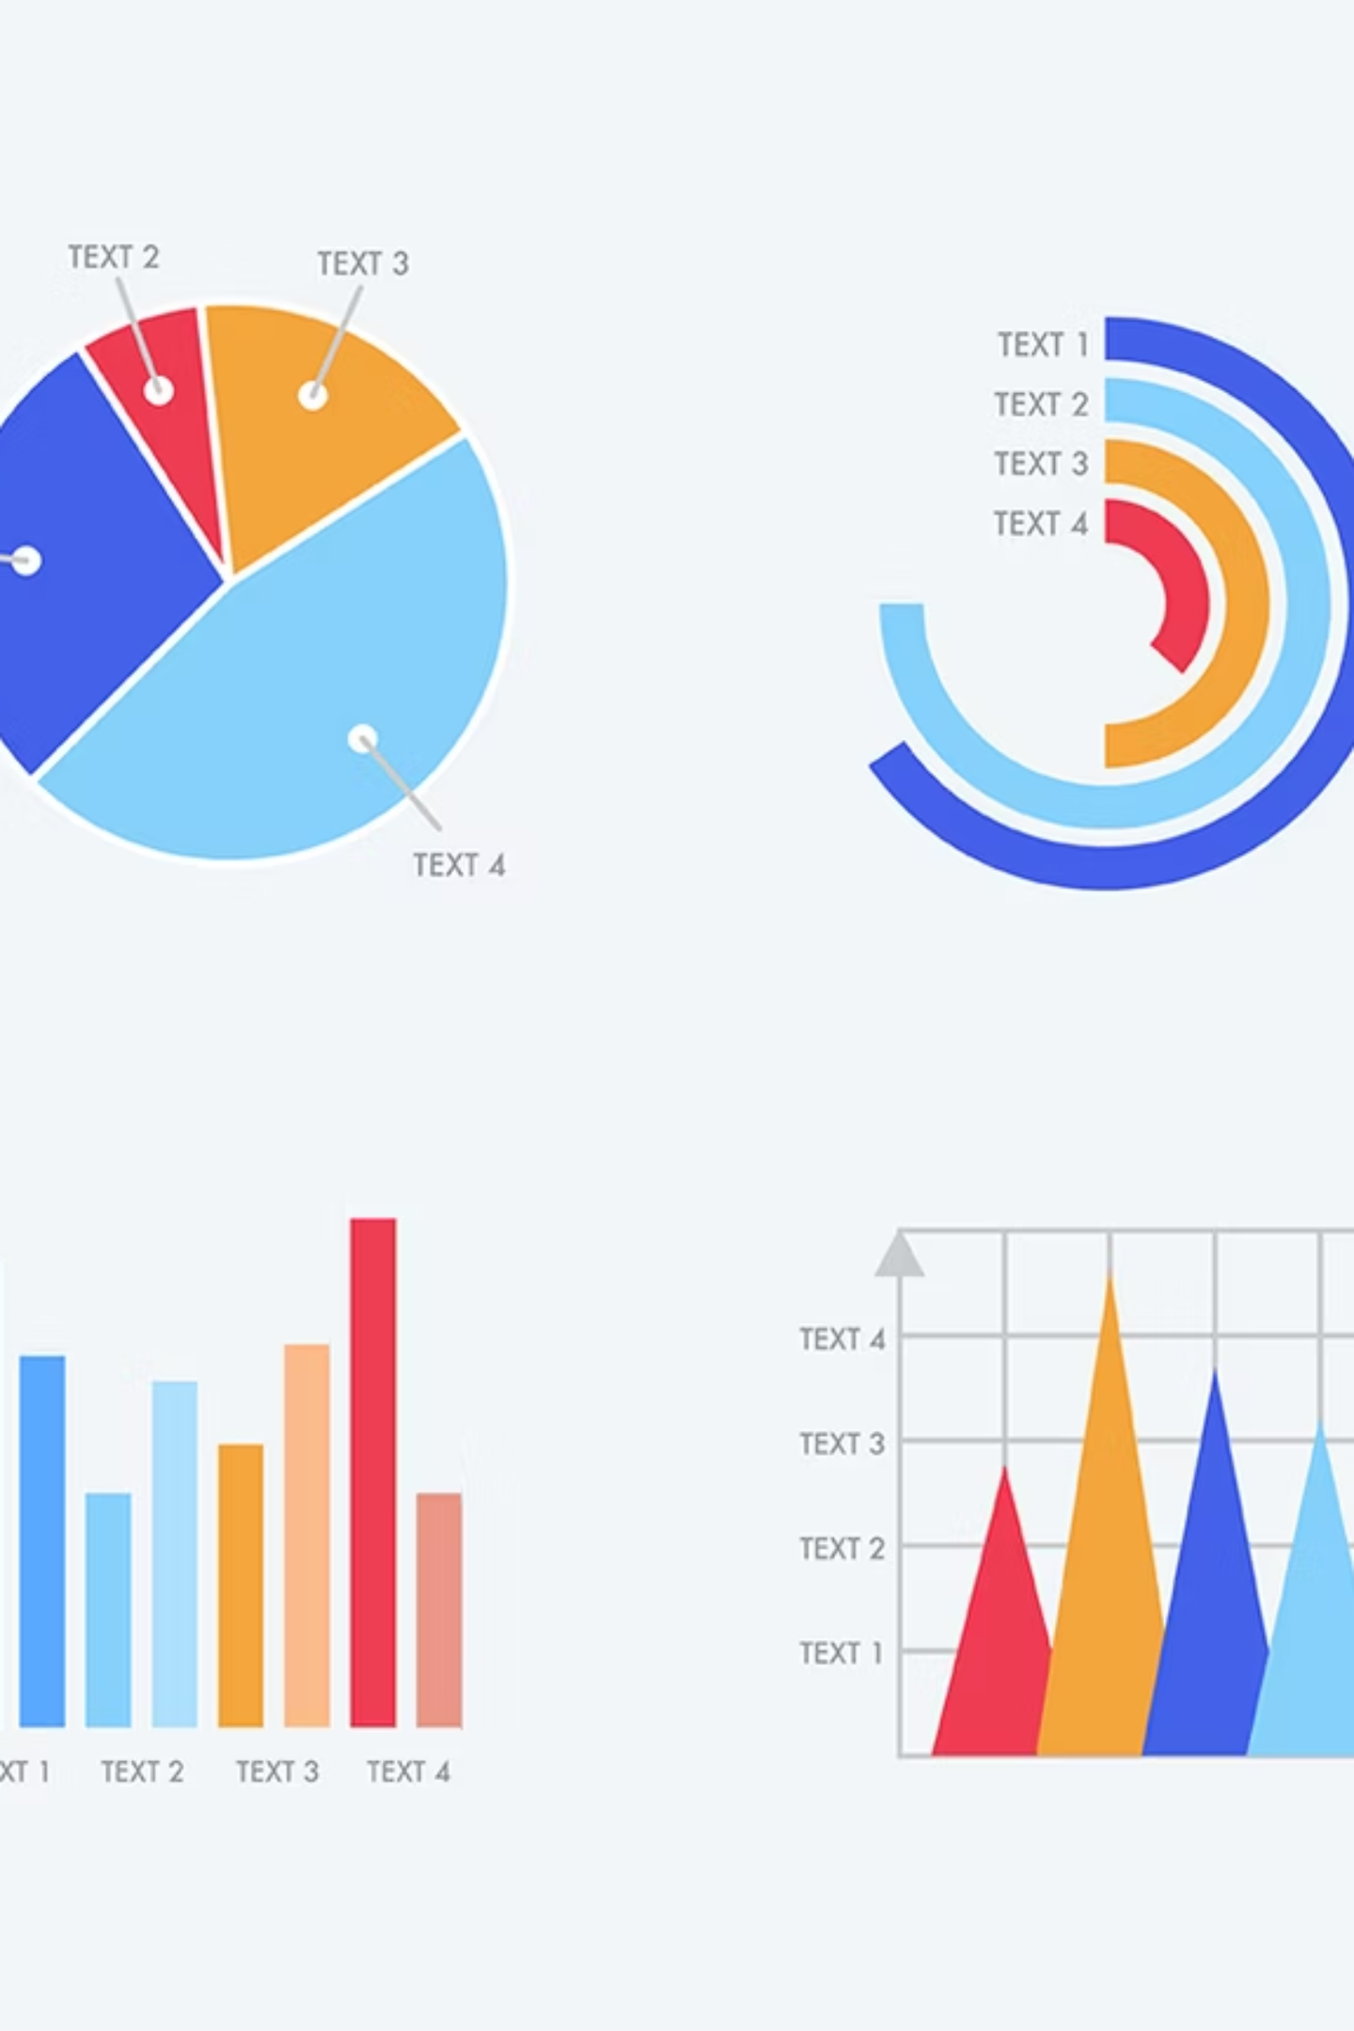
Exploratory Data Analysis (EDA) Overview
Our EDA process was designed to uncover hidden patterns, correlations, and anomalies within the SpaceX launch data, laying the groundwork for robust predictive modeling.
Goals:
Identify underlying patterns and trends in launch success.
Uncover correlations between various mission parameters.
Detect anomalies or outliers that could impact model accuracy.

Slide 6
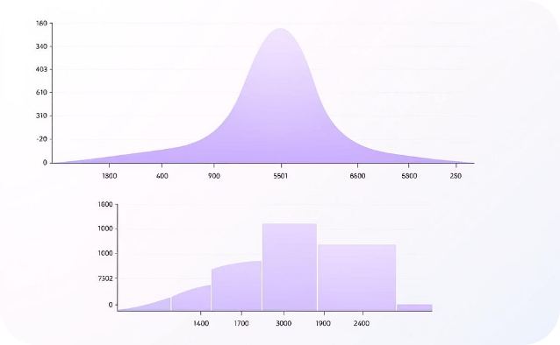
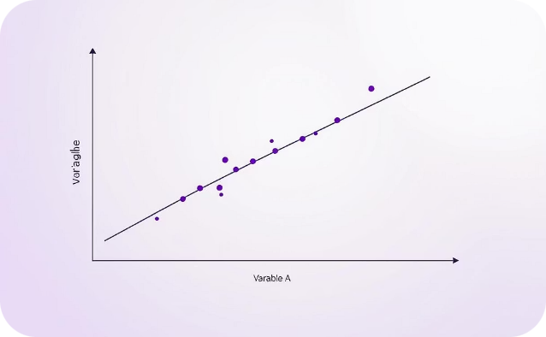
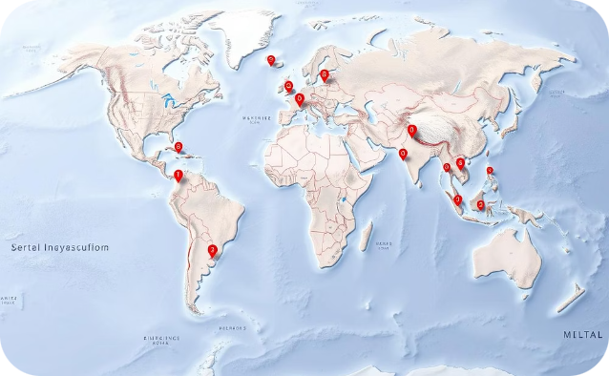
Visual Analytics Methodologies
Our exploratory data analysis heavily relied on advanced visual analytics techniques to gain deeper insights into the Falcon 9 launch data.
Distribution Analysis
Correlation Analysis
Geospatial Analysis
Utilized histograms and box plots to understand the spread, central tendency, and outliers of key numerical features like payload mass and flight number.
Employed scatter plots and heatmaps to visualize relationships between variables, identifying potential correlations affecting landing success.
Leveraged interactive maps (e.g., Folium) to visualize launch sites, landing zones, and their geographical impact on mission outcomes.

Slide 7








Distribution Analysis: Data Characteristics
Understanding variable distributions provided key insights into Falcon 9 launch data, informing potential influences on landing success.
Payload Mass
Flight Number
Analyzed payload mass distribution for correlation with landing outcomes; histograms revealed common ranges.
Examined flight number distribution for trends in success rates as technology refined.
Outlier Detection
Impact on Success
Box plots identified unusual data points (e.g., heavy payloads, early flights) crucial for model robustness.
Linked variable distributions to landing success rates, observing parameter effect on recovery probability.
Correlation Analysis: Uncovering Relationships
Our analysis identified how different mission parameters relate to Falcon 9 first stage landing success.
Identifying Relationships
Payload Mass Impact
Examined how variables influence each other and landing outcomes.
Investigated how varying payload masses affect landing success rates.
Flight Number Progression
Visualizing Connections
Analyzed increased flight numbers and improved landing reliability over time.
Scatter plots and heatmaps visually represented correlation strength and direction.
Geospatial Analysis: Mapping Success
We used geospatial analysis to visualize geographical factors influencing Falcon 9 landing success.
Launch Sites
Landing Zones
Flight Paths
Analyzed success rates from global launchpads to identify optimal starting points.
Distinguished land vs. drone ship recovery, assessing unique challenges.
Visualized trajectories to understand environmental and spatial impacts.

Slide 8


Predictive Analysis Methodology
Building an accurate prediction model involved rigorously testing several classification algorithms and evaluating their performance based on key metrics.
Algorithms Tested
Evaluation Metrics
Logistic Regression
Accuracy: Overall correctness of predictions.
Decision Tree Classifier
F1-score: Balance between precision and recall, especially for imbalanced datasets.
Support Vector Machine (SVM)
K-Nearest Neighbors (KNN)

Slide 9
EDA Results:
Our exploratory data analysis revealed critical factors influencing Falcon 9 first stage landing success, providing valuable insights for future mission planning.
Launch Site Significance
Payload Mass Influence
Reusability Correlation
Analysis showed a notable difference in success rates across launch sites, with KSC LC 39A demonstrating superior performance, indicating optimized operational conditions.
Success rates generally improved with payload mass up to an optimal range, suggesting that missions with very heavy payloads introduce additional landing complexities.
Interestingly, data indicated that more frequently reused boosters achieved higher landing success rates, underscoring the benefits of experience and iterative improvements.

Slide 10
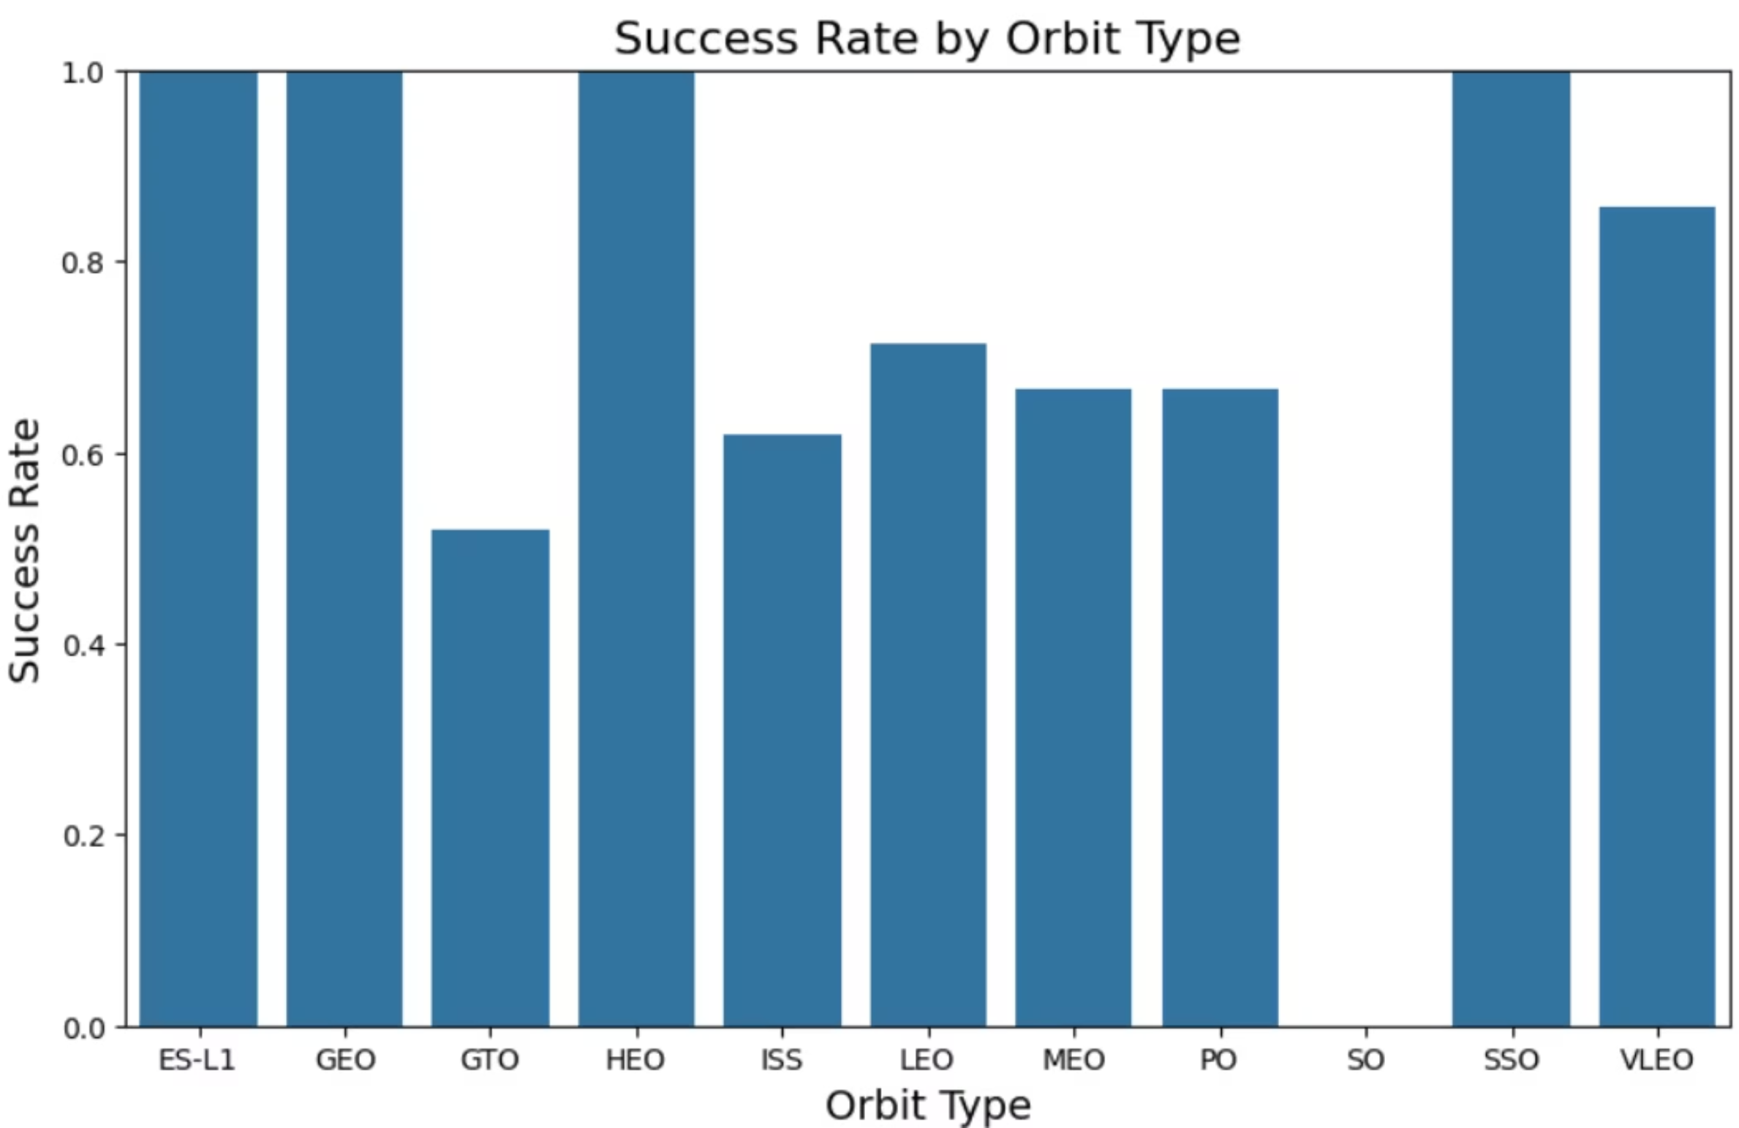
Success Rate by Orbit Type
Visualizing the data provided critical insights into factors influencing Falcon 9 landing success. This chart highlighted the impact of Orbit Type and Success Rate.
Bar chart showing success rates across different Orbit Types

Slide 11
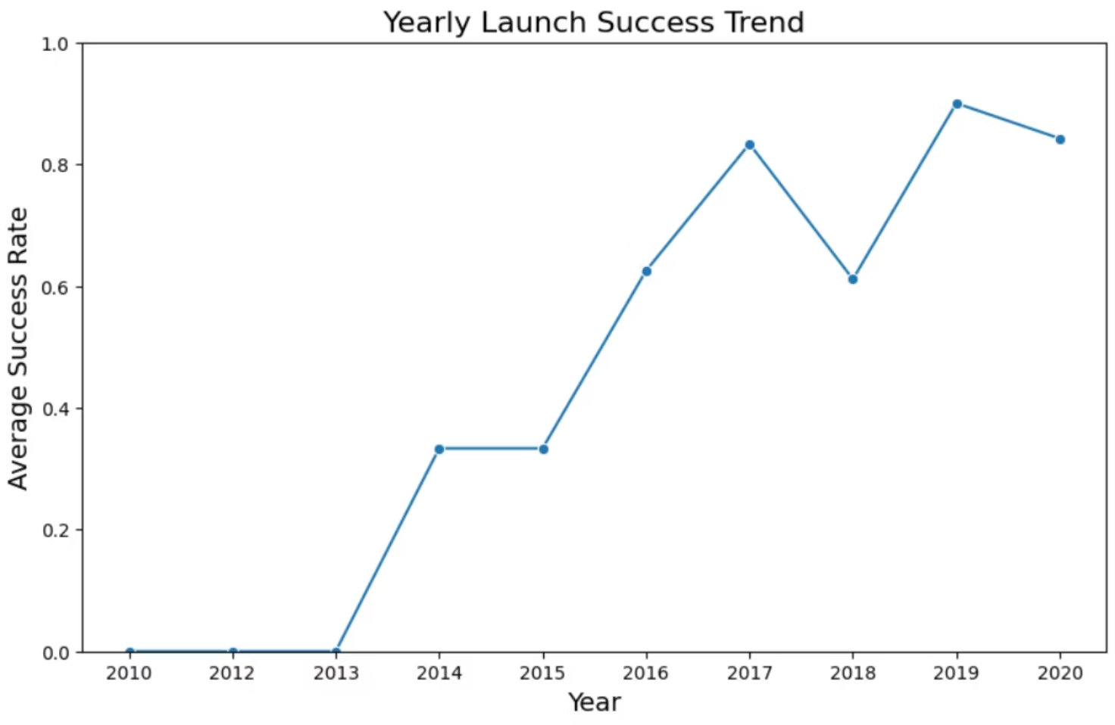
Evolution of Landing Success Rate Over Time
Analyzing the average success rate of Falcon 9 first stage landings reveals a clear trend of continuous improvement over the years, a testament to SpaceX's iterative design and operational enhancements.

Slide 12
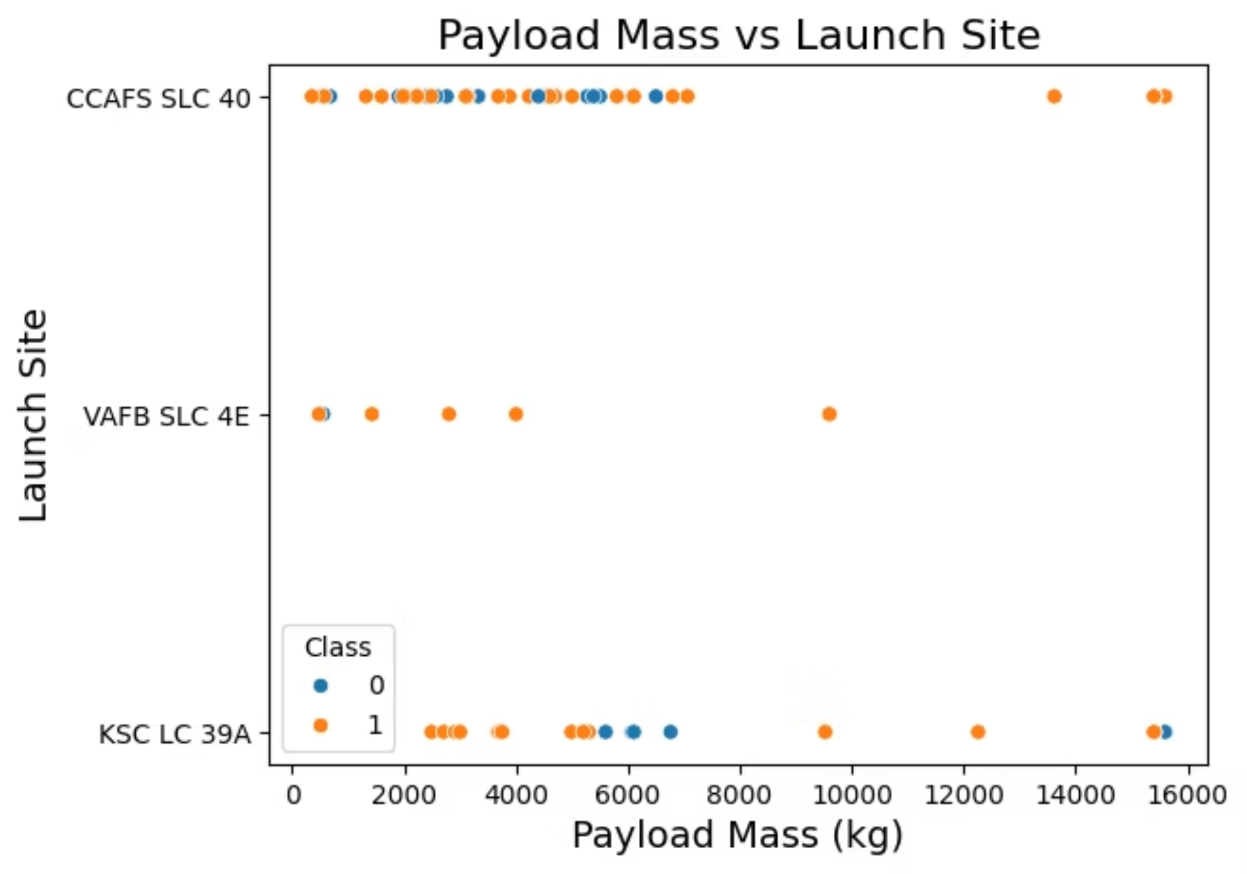
Payload Mass and Launch Site Influence
This scatter plot visualizes the intricate relationship between payload mass, launch site, and the ultimate success of Falcon 9 first stage landings. It helps pinpoint specific operational conditions and their impact on reusability.

Slide 13
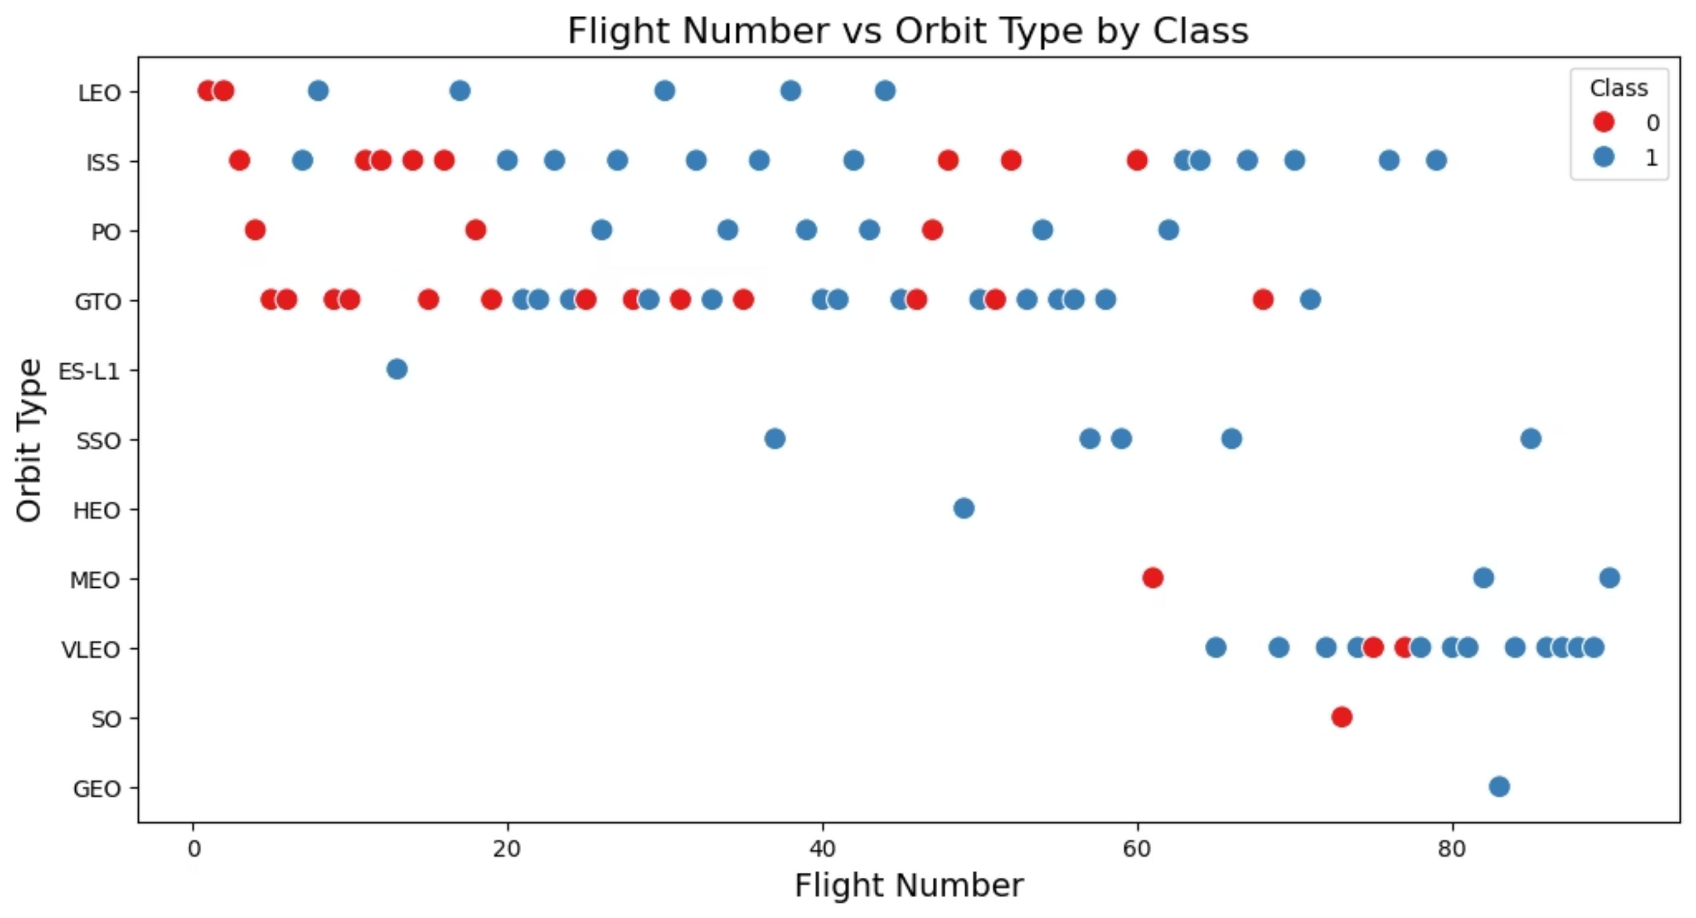
Flight Number and Orbit Type: Mapping Success Trajectories
This scatter plot illustrates the combined influence of increasing flight numbers and diverse orbit types on Falcon 9 first stage landing success. It highlights how operational experience and mission parameters interact to determine reusability outcomes.

Slide 14
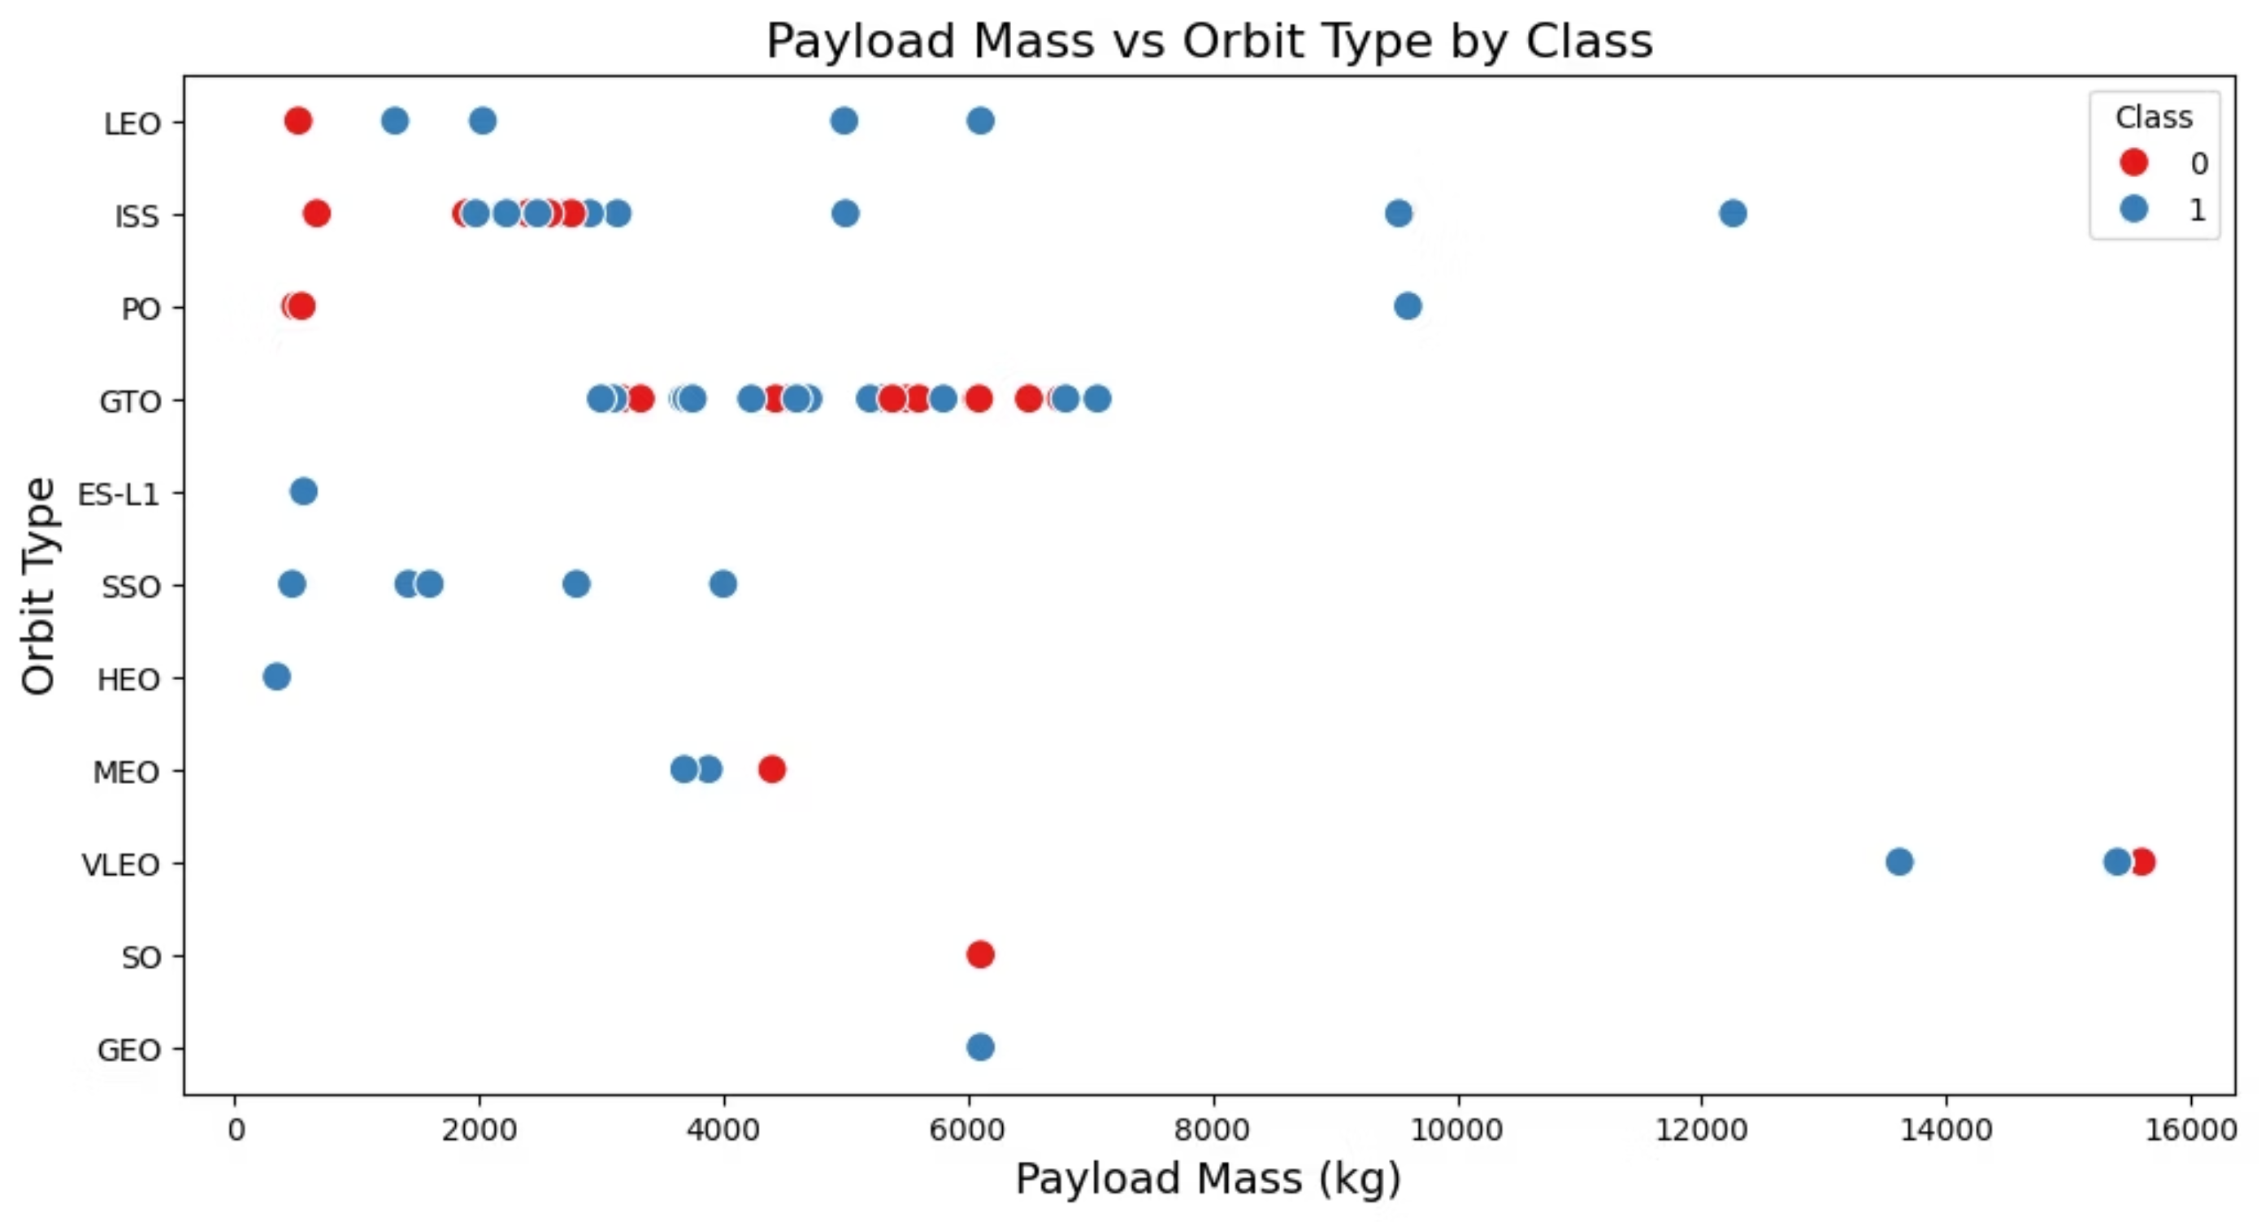
Payload Mass vs. Orbit Type: Success by Class
This scatter plot delves into the interplay between payload mass, the specific orbit type, and the ultimate success of Falcon 9 first stage landings. It offers a granular view of how varying mission parameters, particularly the orbital destination and payload weight, influence reusability outcomes.

Slide 15
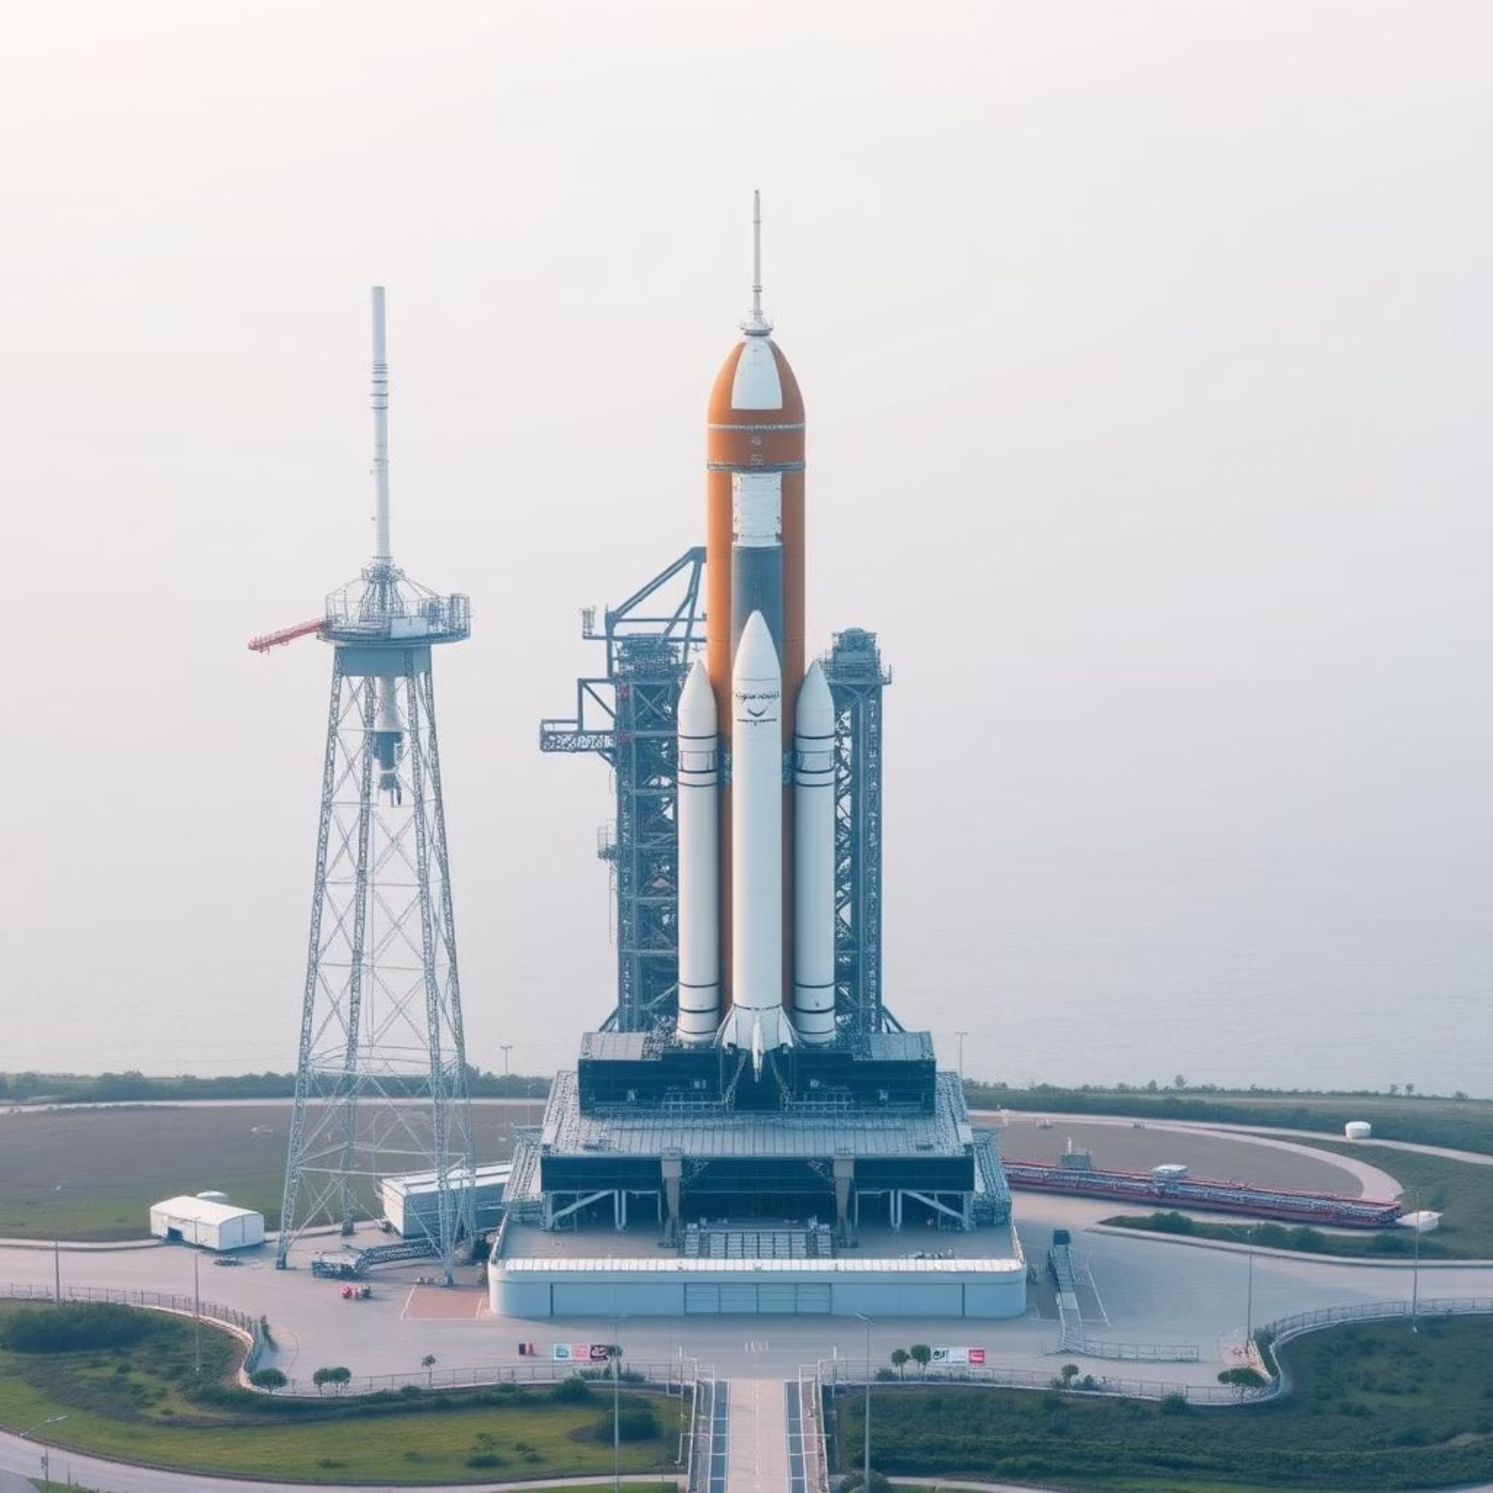
EDA with SQL: Uncovering Data Patterns
SQL queries were instrumental in extracting aggregated insights and validating initial hypotheses during our exploratory data analysis, providing a structured approach to understanding the data.
Launch Site Performance Analysis
This query helped us quantify landing success rates across different launch sites, clearly showing which locations demonstrated higher reliability. KSC LC 39A stood out with the highest success rate, confirming our visual observations.
SELECT launch_site, COUNT(*) AS total_launches, SUM(CASE WHEN landing_success = 1 THEN 1 ELSE 0 END) AS successful_landings, AVG(CASE WHEN landing_success = 1 THEN 1.0 ELSE 0.0 END) AS success_rateFROM falcon9_launchesGROUP BY launch_siteORDER BY success_rate DESC;

Slide 16
Unique Launch Sites: Identifying Operational Hubs
To further understand the operational landscape, we identified all unique launch sites used for Falcon 9 missions, providing a clear overview of SpaceX's primary launch infrastructure.
SQL Query for Unique Launch Sites
Identified Launch Sites
CCAFS LC-40
SELECT DISTINCT Launch_SiteFROM falcon9_launches;
VAFB SLC-4E
KSC LC-39A
CCAFS SLC-40
These four locations represent the key operational hubs for Falcon 9 launches, each contributing to the diverse mission profiles and reusability efforts of SpaceX.

Slide 17
Early Missions: Cape Canaveral Launch Data
To examine the foundational missions from Cape Canaveral, we extracted the initial launch data for Falcon 9 flights originating from the CCAFS (Cape Canaveral Air Force Station) launch sites. This provides a glimpse into the early operational characteristics and outcomes.
Python/Pandas Query for Initial CCAFS Launches
df[df['Launch_Site'].str.startswith('CCA')].head(5)
The table below summarizes the first five Falcon 9 launches from Cape Canaveral, detailing mission parameters and initial landing outcomes, highlighting the early stages of reusability attempts.
Date
Time (UTC)
Booster_Version
Launch_Site
Payload
PAYLOAD_MASS__KG_
Orbit
Customer
Mission_Outcome
Landing_Outcome
2010-06-04
18:45:00
F9 v1.0 B0003
CCAFS LC-40
Dragon Spacecraft Qualification Unit
0
LEO
SpaceX
Success
Failure (parachute)
2010-12-08
15:43:00
F9 v1.0 B0004
CCAFS LC-40
Dragon demo flight C1, two CubeSats, barrel of...
0
LEO (ISS)
NASA (COTS) NRO
Success
Failure (parachute)
2012-05-22
7:44:00
F9 v1.0 B0005
CCAFS LC-40
Dragon demo flight C2
525
LEO (ISS)
NASA (COTS)
Success
No attempt
2012-10-08
0:35:00
F9 v1.0 B0006
CCAFS LC-40
SpaceX CRS-1
500
LEO (ISS)
NASA (CRS)
Success
No attempt
2013-03-01
15:10:00
F9 v1.0 B0007
CCAFS LC-40
SpaceX CRS-2
677
LEO (ISS)
NASA (CRS)
Success
No attempt

Slide 18
Payload Mass for NASA (CRS) Missions
To understand the scale of critical missions, we calculated the total payload mass transported for NASA's Commercial Resupply Services (CRS) missions by Falcon 9 boosters.
Python/Pandas Query for NASA (CRS) Payload
This query aggregates the payload mass for all missions designated for NASA's Commercial Resupply Services, a crucial program for supplying the International Space Station. The results highlight the significant role Falcon 9 plays in space logistics.
total_payload_mass = df[df['Customer'] == 'NASA (CRS)']['PAYLOAD_MASS__KG_'].sum()print("Total payload mass carried by boosters launched by NASA (CRS):", total_payload_mass, "kg")
Total payload mass carried by boosters launched by NASA (CRS): 45596 kg

Slide 19
Payload Mass: Falcon 9 v1.1 Evolution
Understanding the payload capabilities of different Falcon 9 versions is crucial for mission planning. We specifically analyzed the average payload mass for the F9 v1.1 booster, marking a significant step in SpaceX's development.
Python/Pandas Query for F9 v1.1 Payload
The Falcon 9 v1.1 represented a major upgrade, enabling heavier payloads and more ambitious missions. This calculation quantifies its enhanced capacity, directly supporting the transition to more robust launch capabilities.
avg_payload_f9_v1_1 = df[df['Booster_Version'] == 'F9 v1.1']['PAYLOAD_MASS__KG_'].mean()print("Average payload mass carried by booster version F9 v1.1:", avg_payload_f9_v1_1, "kg")
Average payload mass carried by booster version F9 v1.1: 2928.4 kg

Slide 20
First Ground Pad Landing Success
We identified the precise date of SpaceX's first successful Falcon 9 booster landing on a ground pad, a pivotal moment in reusability history.
Python/Pandas Query
This query pinpoints the exact date when SpaceX achieved its first successful propulsive landing back at a ground site. This achievement proved the viability of reusability, opening new frontiers for space exploration.
first_ground_pad_landing = df[df['Landing_Outcome'] == 'Success (ground pad)']['Date'].min()print("Date of first successful landing outcome in ground pad:", first_ground_pad_landing)
Date of first successful landing outcome in ground pad: 2015-12-22

Slide 21
Identifying Successful Drone Ship Landings by Payload Mass
We refined our analysis to identify specific Falcon 9 booster versions that achieved successful drone ship landings with a payload mass between 4000 kg and 6000 kg.
Python/Pandas Query
This query specifically targets boosters that demonstrated successful reusability on autonomous drone ships while carrying significant, but not extremely heavy, payloads. The identified versions represent a key phase in developing reliable ocean landings.
boosters = df[ (df['Landing_Outcome'] == 'Success (drone ship)') & (df['PAYLOAD_MASS__KG_'] > 4000) & (df['PAYLOAD_MASS__KG_'] < 6000)]['Booster_Version'].unique()print("Boosters with success in drone ship and payload mass between 4000 and 6000 kg:", boosters)
Identified Boosters: ['F9 FT B1022', 'F9 FT B1026', 'F9 FT B1021.2', 'F9 FT B1031.2']

Slide 22
Mission Outcome Analysis
We analyzed the overall mission outcomes for all Falcon 9 launches, categorizing them into successes and failures based on the "Mission_Outcome" column. This provides a comprehensive overview of the program's reliability.
Python/Pandas Query for Mission Outcomes
The query directly counts the occurrences of "success" and "failure" within the mission outcomes, providing a clear statistical measure of the Falcon 9's operational history.
success_count = df[df['Mission_Outcome'].str.lower().str.contains('success')].shape[0]failure_count = df[df['Mission_Outcome'].str.lower().str.contains('failure')].shape[0]print("Total successful mission outcomes:", success_count)print("Total failure mission outcomes:", failure_count)
100
1
Successful Missions
Mission Failure
Highlighting consistent reliability and operational excellence.
Demonstrating the rare occurrence of mission anomalies.
The data unequivocally demonstrates SpaceX's exceptional track record, with an overwhelming majority of Falcon 9 missions achieving their objectives. This high success rate is a testament to continuous innovation and rigorous operational protocols, solidifying Falcon 9's position as a highly dependable launch vehicle.

Slide 23
Maximum Payload Lifters: Identifying Key Booster Versions
We identified the specific Falcon 9 booster versions that have carried the absolute maximum payload mass, highlighting the peak of SpaceX's heavy-lift capabilities.
SQL Query for Maximum Payload Boosters
This analysis pinpoints the specific booster versions of the Falcon 9 that have successfully launched the heaviest payloads. These versions showcase the advancements in SpaceX's design and engineering, demonstrating their capacity for the most demanding missions.
SELECT Booster_VersionFROM SPACEXTBLWHERE PAYLOAD_MASS__KG_ = ( SELECT MAX(PAYLOAD_MASS__KG_) FROM SPACEXTBL)
Identified Boosters: ['F9 B5 B1048.4', 'F9 B5 B1049.4', 'F9 B5 B1051.3', 'F9 B5 B1056.4', 'F9 B5 B1048.5', 'F9 B5 B1051.4', 'F9 B5 B1049.5', 'F9 B5 B1060.2', 'F9 B5 B1058.3', 'F9 B5 B1051.6', 'F9 B5 B1060.3', 'F9 B5 B1049.7']
The numerous booster versions listed indicate continuous refinement and reusability of these powerful vehicles, each contributing to the record for maximum payload delivery.

Slide 24

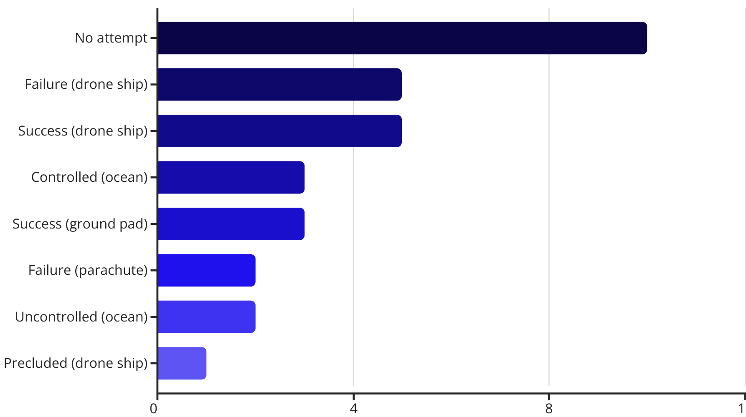
Early Drone Ship Landing Challenges (2015)
This analysis specifically targets Falcon 9 drone ship landing failures during 2015, highlighting the initial challenges in achieving booster reusability at sea.
SQL Query for 2015 Drone Ship Failures
The query identifies specific instances where drone ship landing attempts in 2015 resulted in failure, providing critical data points for understanding early operational hurdles.
SELECT CASE substr(Date, 6, 2) WHEN '01' THEN 'January' WHEN '02' THEN 'February' WHEN '03' THEN 'March' WHEN '04' THEN 'April' WHEN '05' THEN 'May' WHEN '06' THEN 'June' WHEN '07' THEN 'July' WHEN '08' THEN 'August' WHEN '09' THEN 'September' WHEN '10' THEN 'October' WHEN '11' THEN 'November' WHEN '12' THEN 'December' END AS Month_Name, Landing_Outcome, Booster_Version, Launch_SiteFROM SPACEXTBLWHERE substr(Date, 0, 5) = '2015' AND Landing_Outcome LIKE '%Failure (drone ship)%'
Identified Drone Ship Failures in 2015:
January: F9 v1.1 B1012 from CCAFS LC-40April: F9 v1.1 B1015 from CCAFS LC-40
These early setbacks were crucial learning experiences, driving SpaceX's iterative design and operational improvements that eventually led to routine drone ship landings.
Early Landing Outcome Breakdown (2010-2017)
This analysis focuses on the distribution of Falcon 9 landing outcomes during the crucial early phase of reusability development, from June 2010 to March 2017.
Python/Pandas Query
The query provides a detailed breakdown of all attempted and unattempted landing outcomes within the specified period, illustrating the challenges and early successes in SpaceX's reusability efforts.
landing_counts = df[ (df['Date'] >= '2010-06-04') & (df['Date'] <= '2017-03-20')]['Landing_Outcome'].value_counts().sort_values(ascending=False)print(landing_counts)
This data highlights the iterative development process, with a significant number of "No attempt" and "Failure" outcomes in the early years, alongside the nascent "Success (drone ship)" and "Success (ground pad)" entries demonstrating the gradual mastery of landing technologies. The equal count of "Failure (drone ship)" and "Success (drone ship)" indicates the critical learning curve associated with sea-based recovery.

Slide 25
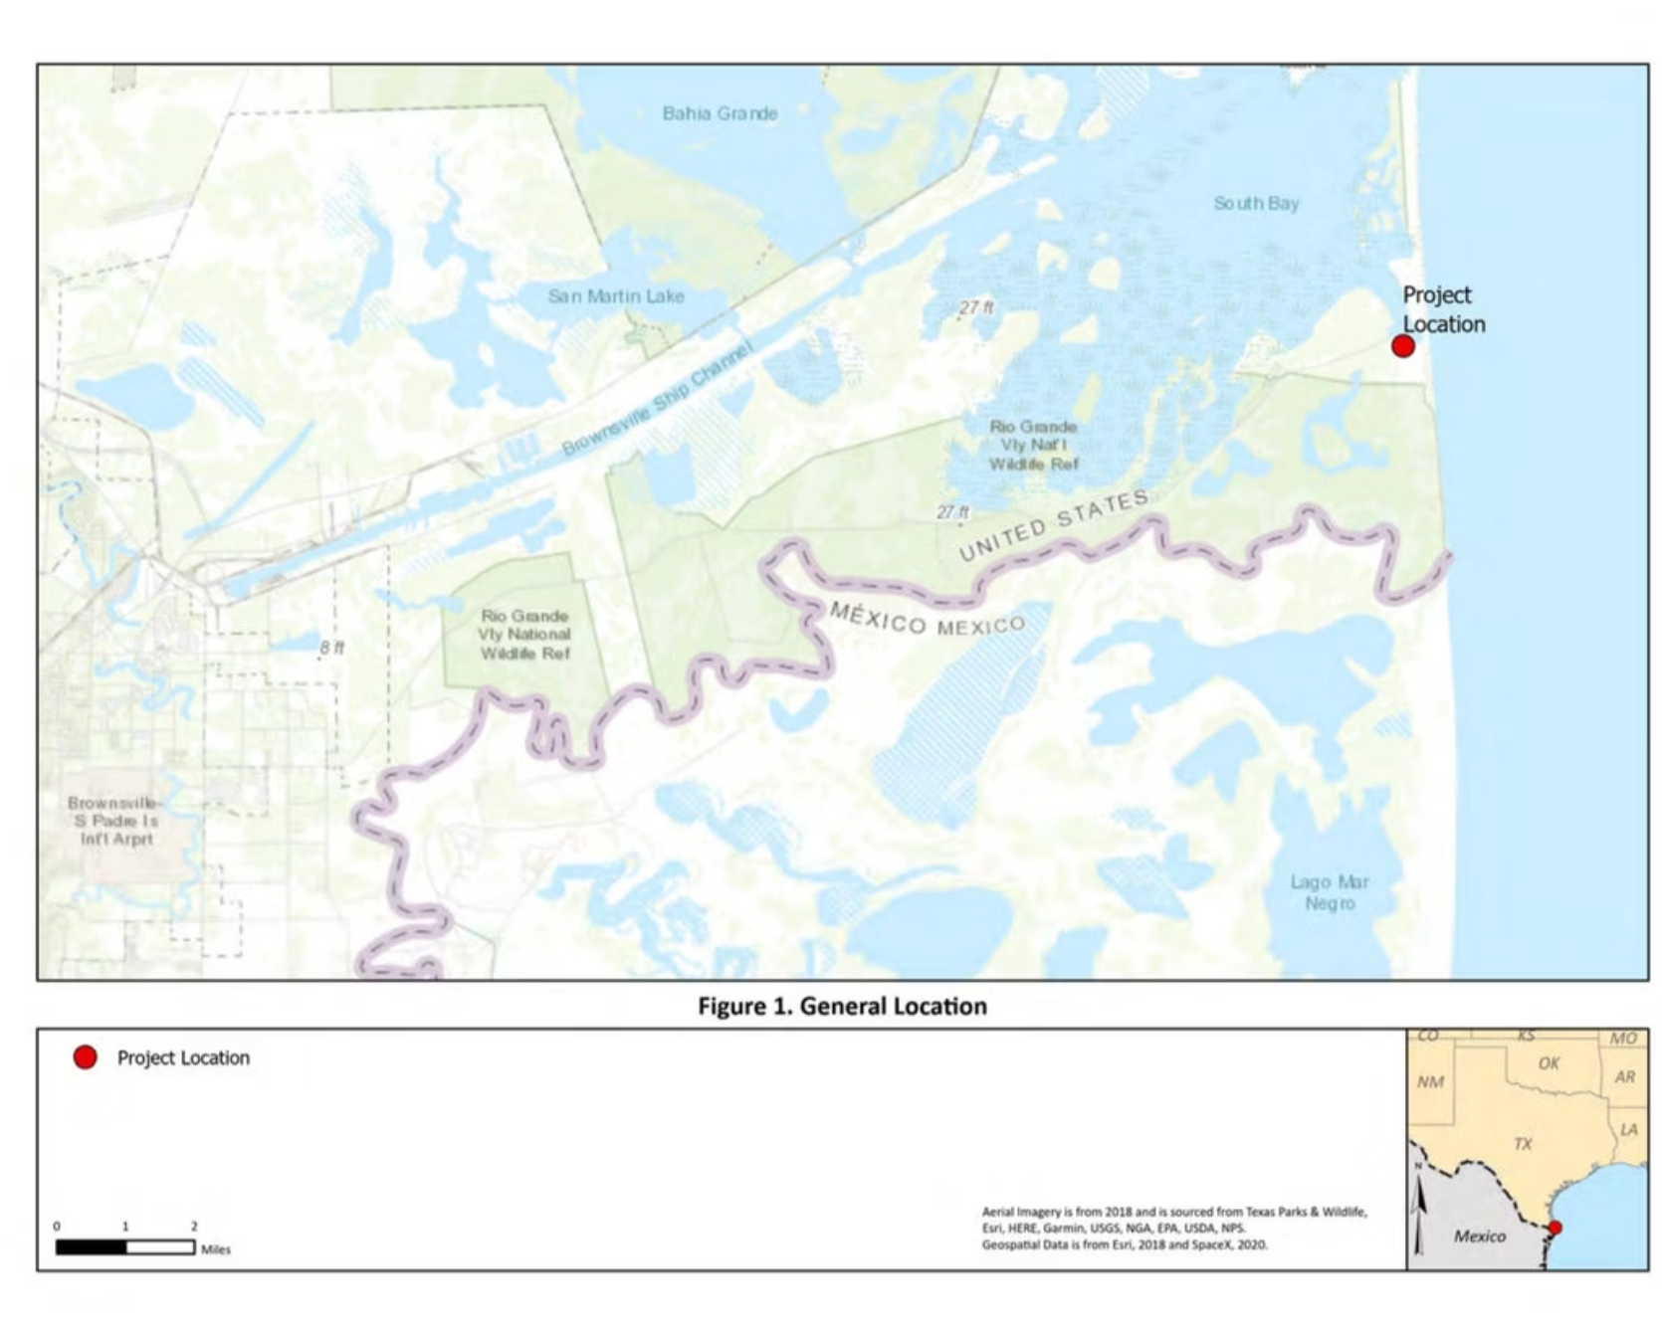
Interactive Geospatial Analysis with Folium
We leveraged Folium to create interactive maps, visualizing the geographical distribution of launch sites and landing outcomes. This allowed for a deeper, location-based understanding of mission success factors.
Visualizing Launch & Landing Sites
Geographical spread of successful vs. failed landings.
Identification of common landing zones (ocean vs. land).
Analysis of environmental factors at specific locations.

Slide 26
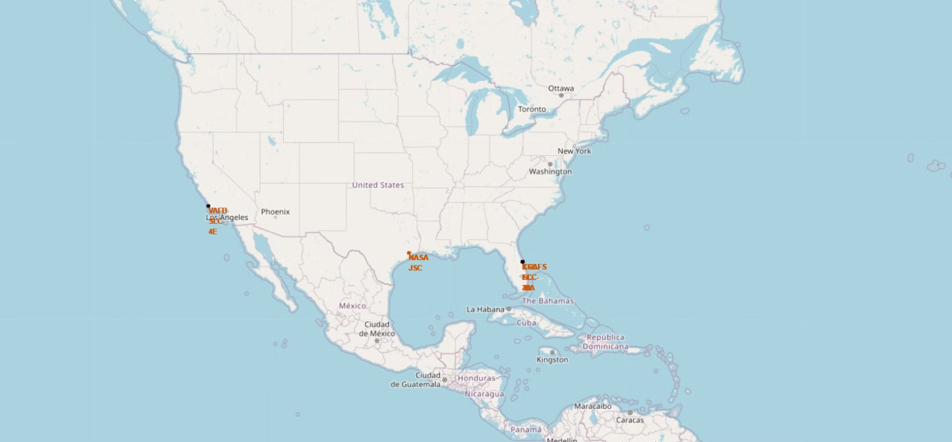
Mapping Launch Sites with Folium
This segment details the Python code used to dynamically add interactive markers and circles for each SpaceX launch site onto our Folium map, enhancing the geospatial analysis.
Python Code: Adding Site Markers
The script iterates through launch site data, placing a black circle and a distinct text marker at each location. This interactive visualization allows for immediate identification and contextual understanding of every launch origin point on the map.
# Add a circle and marker for each launch sitefor idx, row in launch_sites_df.iterrows(): coordinate = [row['Lat'], row['Long']] circle = folium.Circle( coordinate, radius=1000, color='#000000', fill=True ).add_child(folium.Popup(row['Launch Site'])) site_map.add_child(circle) marker = folium.map.Marker( coordinate, icon=DivIcon( icon_size=(20, 20), icon_anchor=(0, 0), html='<div style="font-size: 12; color:#d35400;"><b>%s</b></div>' % row['Launch Site'], ) ) site_map.add_child(marker) site_map

Slide 27
Launch Site Distance Analysis
To better understand the logistical and strategic relationships between SpaceX's operational hubs, we performed a geodesic distance calculation for all major launch sites.
Python Code: Geodesic Distance Calculation
Inter-Site Distances (km)
from geopy.distance import geodesic# Calculate distances from each launch site to all other launch sitesdistances = []for i, site1 in launch_sites_df.iterrows(): coord1 = (site1['Lat'], site1['Long']) for j, site2 in launch_sites_df.iterrows(): if i != j: coord2 = (site2['Lat'], site2['Long']) distance_km = geodesic(coord1, coord2).kilometers distances.append({ 'From': site1['Launch Site'], 'To': site2['Launch Site'], 'Distance_km': distance_km })distances_df = pd.DataFrame(distances)distances_df
The table below shows the calculated geodesic distances between each pair of SpaceX launch sites, offering insight into their geographical proximity.
From
To
Distance (km)
CCAFS LC-40
CCAFS SLC-40
0.11
CCAFS LC-40
KSC LC-39A
6.91
CCAFS LC-40
VAFB SLC-4E
3833.07
CCAFS SLC-40
CCAFS LC-40
0.11
CCAFS SLC-40
KSC LC-39A
6.95
CCAFS SLC-40
VAFB SLC-4E
3833.08
KSC LC-39A
CCAFS LC-40
6.91
KSC LC-39A
CCAFS SLC-40
6.95
KSC LC-39A
VAFB SLC-4E
3826.27
VAFB SLC-4E
CCAFS LC-40
3833.07
VAFB SLC-4E
CCAFS SLC-40
3833.08
VAFB SLC-4E
KSC LC-39A
3826.27
As observed, the launch sites on Florida's Space Coast (CCAFS LC-40, CCAFS SLC-40, KSC LC-39A) are extremely close to one another, reflecting their shared operational region. In contrast, VAFB SLC-4E on the West Coast is thousands of kilometers away, highlighting the geographical separation of East and West Coast launch capabilities.

Slide 28



Plotly Dash Dashboard
The interactive Plotly Dash dashboard enabled dynamic exploration, revealing deeper insights into the factors contributing to Falcon 9 landing success.
Booster Version Performance
Progress Over Time
Specific Landing Site Effectiveness
The dashboard revealed significant performance variations among different booster versions, with newer iterations demonstrating superior reliability in landing attempts.
Filtering by launch year clearly illustrated a consistent upward trend in landing success rates as SpaceX accumulated experience and refined its reusability technology.
Granular analysis highlighted distinctions in success rates between various drone ships and land pads, allowing for an in-depth understanding of localized operational challenges.

Slide 29
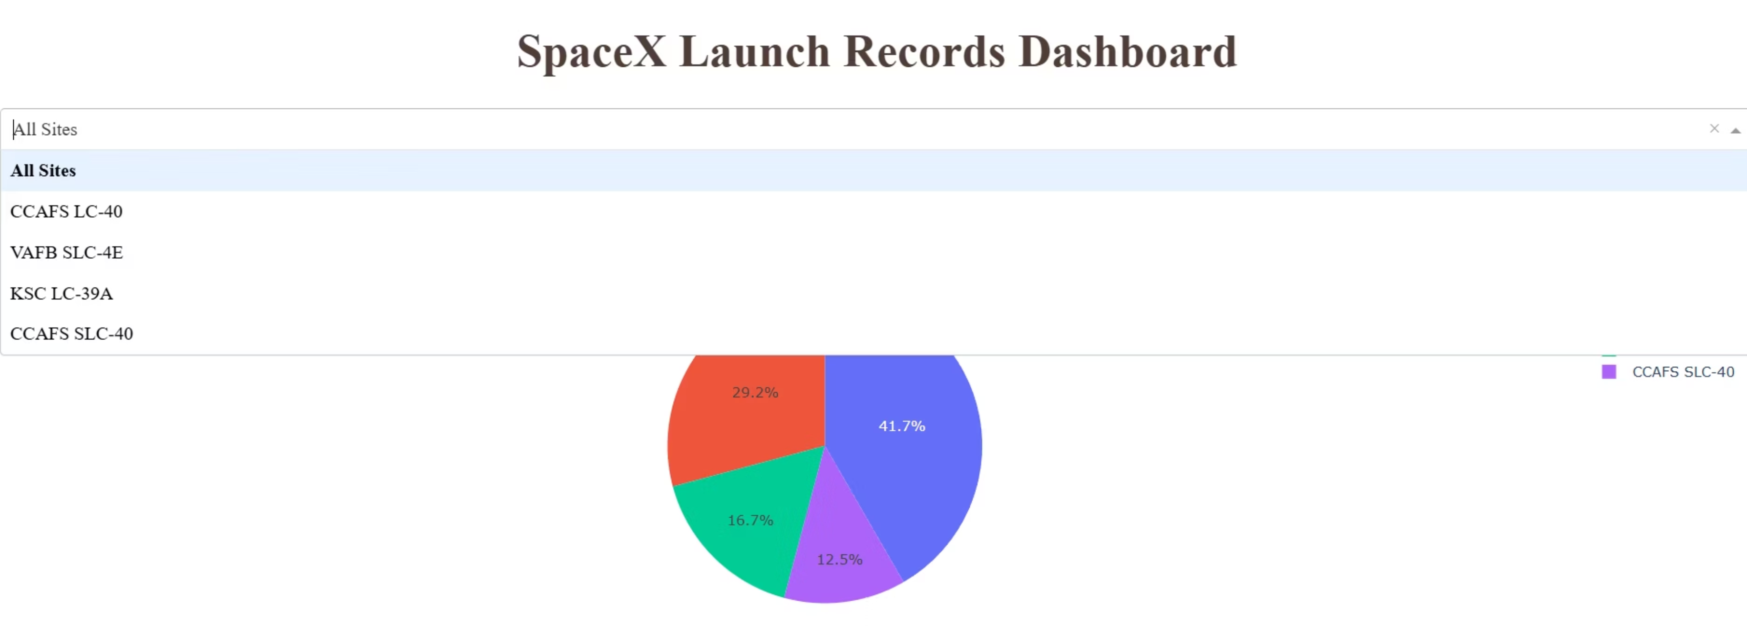
Launch Site Dropdown Configuration
dcc.Dropdown(id='site-dropdown', options=[ {'label': 'All Sites', 'value': 'ALL'} ] + [ {'label': site, 'value': site} for site in spacex_df['Launch Site'].unique() ], value='ALL', placeholder="Select a Launch Site here", searchable=True )

Slide 30
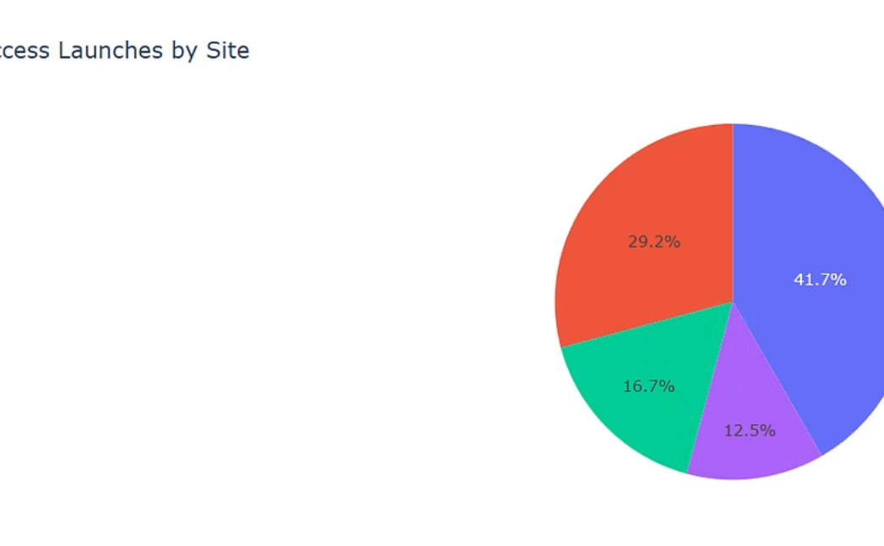
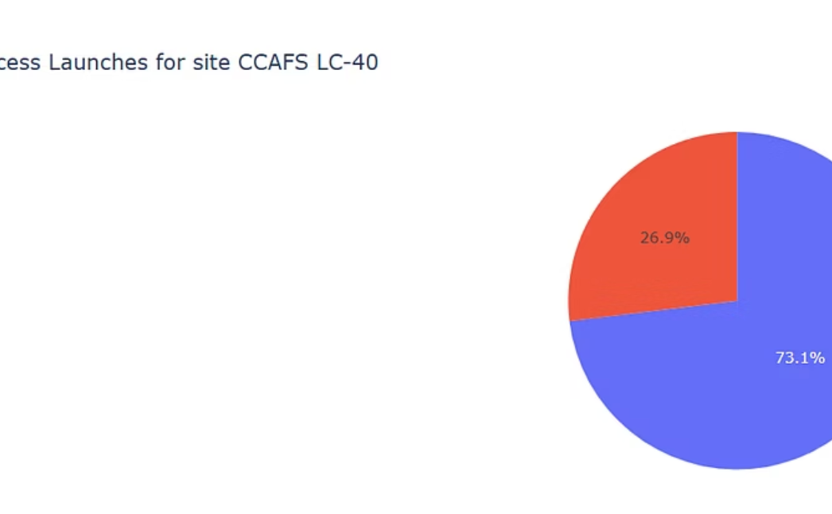
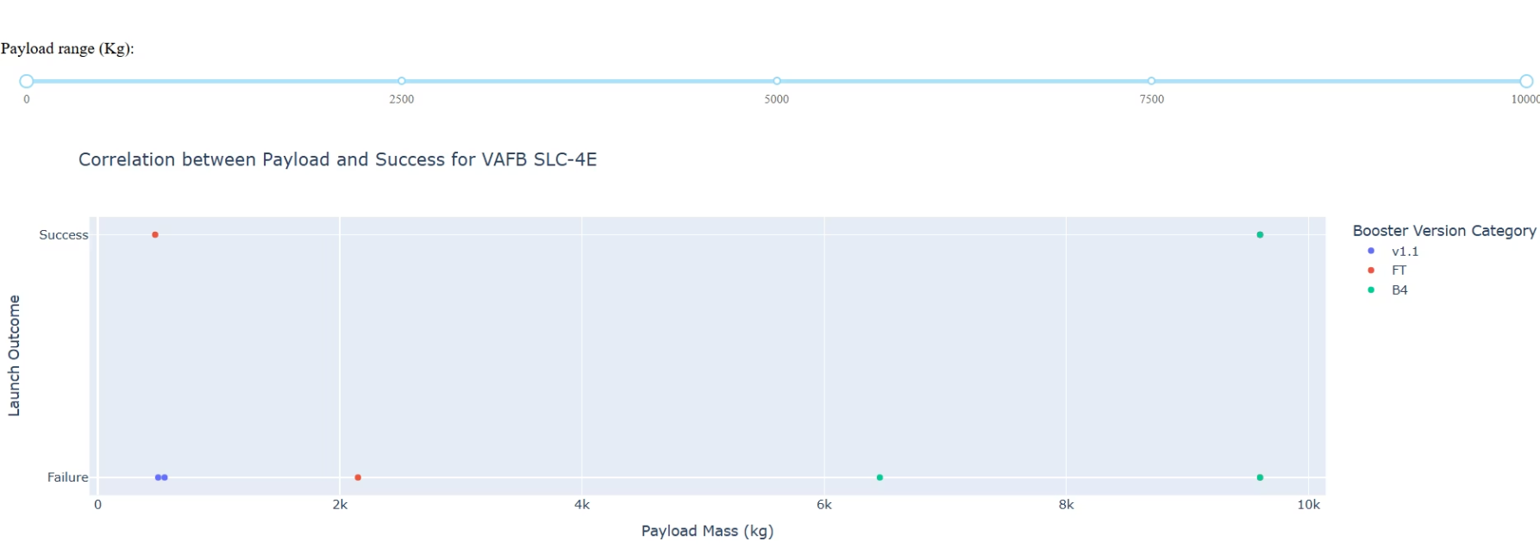
Interactive Pie Chart Callback
This Python code powers the Plotly Dash dashboard's interactive pie chart, enabling dynamic visualization of launch success rates based on user selections.
Python Code: Pie Chart Logic
@app.callback( Output(component_id='success-pie-chart', component_property='figure'), Input(component_id='site-dropdown', component_property='value'))def get_pie_chart(entered_site): if entered_site == 'ALL': fig = px.pie(spacex_df, values='class', names='Launch Site', title='Total Success Launches by Site') return fig else: filtered_df = spacex_df[spacex_df['Launch Site'] == entered_site] fig = px.pie(filtered_df, names='class', title=f'Total Success Launches for site {entered_site}') return fig
Examples of Interactive Pie Charts
Payload Range Slider & Scatter Chart
dcc.RangeSlider(id='payload-slider', min=0, max=10000, step=1000, marks={0: '0', 2500: '2500', 5000: '5000', 7500: '7500', 10000: '10000'}, value=[min_payload, max_payload] ),html.Div(dcc.Graph(id='success-payload-scatter-chart')), ])
The dashboard further integrates a payload mass range slider and a scatter chart to visually explore the correlation between payload mass, launch outcome, and booster versions.
This code defines the interactive range slider for selecting payload mass and sets up the area where the scatter chart will be displayed. Users can adjust the range to focus on specific payload categories.

Slide 31


Fine-Tuning with GridSearchCV
To optimize the performance of our classification models, we employed GridSearchCV, a powerful technique for systematically searching for the best hyperparameters.
Automated Optimization
Exhaustive Search
Enhanced Performance
GridSearchCV automates the process of finding the best combination of hyperparameters, eliminating manual trial-and-error.
It thoroughly explores a defined range of hyperparameter values, ensuring no optimal combination is overlooked.
By identifying the ideal parameters, GridSearchCV significantly improves model accuracy and generalization capabilities on unseen data.

Slide 32
Logistic Regression: A Foundation for Prediction
As a foundational classification algorithm, Logistic Regression provided an essential baseline for predicting Falcon 9 landing success, offering interpretability and a robust starting point for our analysis.
How it Works
Logistic Regression models the probability of a binary outcome (success/failure) using a sigmoid function. This function transforms any real-valued input into a probability between 0 and 1, making it ideal for classification tasks like predicting landing outcomes.
It's particularly valuable for its simplicity and the ability to interpret the impact of each feature on the prediction probability.

Slide 33
Support Vector Machine (SVM): Advanced Classification
A powerful algorithm for classification, Support Vector Machines (SVMs) are adept at finding the optimal boundary to separate data points, especially in high-dimensional spaces.
The Hyperplane and Margin
SVM works by constructing a hyperplane in a high-dimensional space that best separates different classes. The goal is to find the hyperplane with the largest margin—the distance between the hyperplane and the nearest data point from any class. A larger margin reduces the generalization error of the classifier.
This approach makes SVM highly effective for complex, non-linear datasets, often leveraging "kernel tricks" to transform data into higher dimensions where separation becomes more feasible.

Slide 34
Decision Trees: Navigating Data for Prediction
Decision Trees offer an intuitive approach to classification, mimicking human decision-making by splitting data based on feature values until a clear outcome is reached.
How it Works
Decision Trees classify data by recursively partitioning it into subsets. At each node, the algorithm chooses the best feature to split the data, aiming to maximize the homogeneity of the resulting subsets. This process creates a tree-like structure, leading to a decision at each leaf node.
Their interpretability makes them powerful for understanding the logic behind predictions, allowing for clear visualization of the classification rules.

Slide 35
K-Nearest Neighbors (KNN): Proximity for Prediction
K-Nearest Neighbors (KNN) is a versatile, non-parametric algorithm that classifies new data points based on their similarity to existing data.
How it Works
KNN classifies a new observation by finding the 'K' closest data points in the training set. The new observation is then assigned the class that is most common among these 'K' neighbors. Proximity is typically determined by distance metrics like Euclidean distance.
This approach makes KNN intuitive and effective for complex decision boundaries, though sensitive to feature scaling and the choice of 'K'.

Slide 36
Predictive Analysis Results
Our model comparison highlights the varying performance of different classification algorithms in predicting Falcon 9 landing success.
Model
Accuracy
Logistic Regression
0.833
Support Vector Machine
0.833
Decision Tree
0.833
K-Nearest Neighbors
0.833
Key Takeaway: All evaluated models—Logistic Regression, SVM, Decision Tree, and KNN—achieved a high accuracy of 0.833 in predicting Falcon 9 landing success, underscoring the feasibility of robust predictive analytics for SpaceX's operations.

Slide 37


Conclusion
Our comprehensive analysis and predictive modeling mark a significant step towards fully autonomous and reliable Falcon 9 first stage landings.
Predictive Accuracy
Actionable Insights
Future of Space Travel
Achieved high accuracy (0.833 across all evaluated models) in predicting Falcon 9 landing success, validating our analytical approach.
Discovered critical factors influencing landing outcomes through extensive EDA and interactive visualizations, providing deep operational understanding.
This predictive capability directly contributes to SpaceX's mission of making space access more efficient, sustainable, and routine.

Slide 38





Model Insights: A Comparative View
Beyond individual explanations, understanding the comparative strengths of each model helps illuminate our predictive approach for Falcon 9 landings.
Logistic Regression
Support Vector Machine
K-Nearest Neighbors
A simple yet powerful baseline, offering clear interpretability of feature impact on landing probability.
Excels in finding optimal decision boundaries, even in complex, high-dimensional data, through hyperplane optimization.
Classifies new data points based on their similarity to existing data, leveraging the 'K' closest neighbors for intuitive predictions.
Decision Trees
Random Forest
Mimics human reasoning with a clear, hierarchical structure, providing transparent rules for classification decisions.
Our top performer, aggregating multiple decision trees to achieve robust, highly accurate predictions by reducing overfitting.

Slide 39
Random Forest: Ensemble Power for Accuracy
Leveraging the collective intelligence of multiple decision trees, Random Forest emerges as our most robust and accurate model for predicting Falcon 9 landing success.
How it Works
Random Forest operates by constructing a multitude of decision trees during training and outputting the class that is the mode of the classes (classification) or mean prediction (regression) of the individual trees.
This "wisdom of the crowd" approach significantly reduces overfitting and enhances the model's generalization capabilities, making it exceptionally reliable for complex datasets like ours.

